Slide 1

Transformer Interpretability
Concepts and Methods
Julian Schulz 2024

Slide 2

Circuits

Slide 3
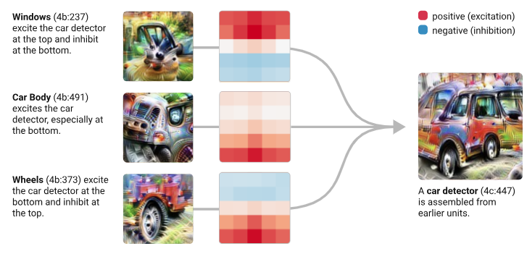
What is a circuit?
A “circuit” is a computational subgraph of a neural network. It consists of a set of features, and the weighted edges that go between them in the original network.
Chris Olah, "Interpretability as a Natural Science" 2020

Slide 4
Why understanding circuits?
In fact, for small enough circuits, statements about their behavior become questions of mathematical reasoning. Of course, the cost of this rigor is that statements about circuits are much smaller in scope than overall model behavior. But it seems like, with sufficient effort, statements about model behavior could be broken down into statements about circuits. If so, perhaps circuits could act as a kind of epistemic foundation for interpretability.
Chris Olah, "Interpretability as a Natural Science" 2020
Also “Interpretability Dreams“ 2023

Slide 5
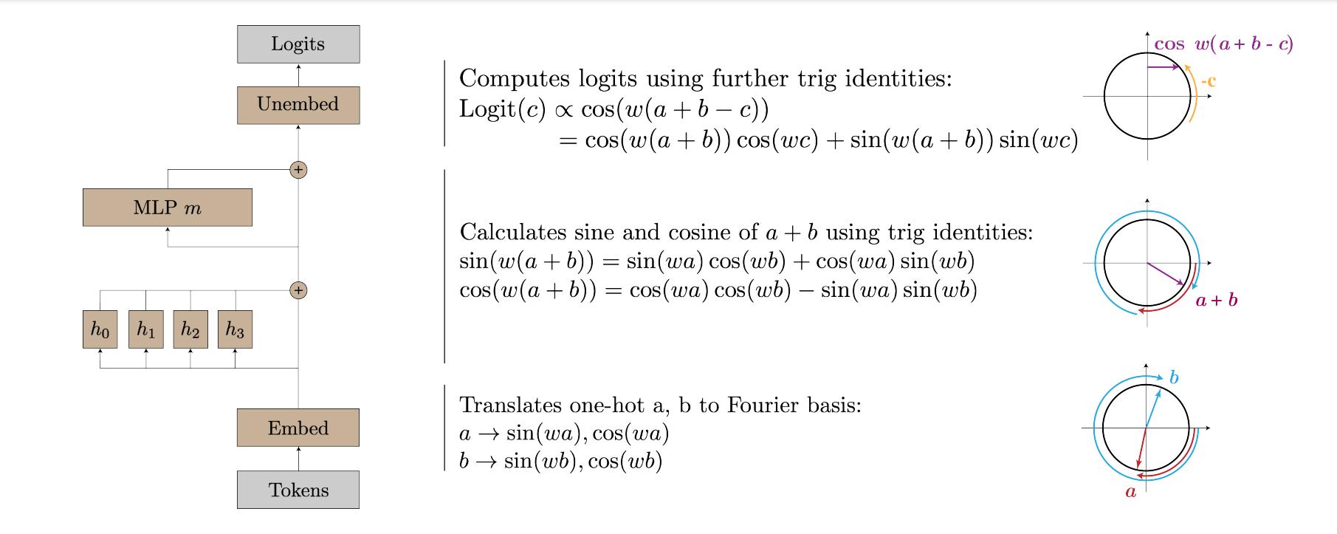
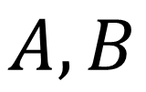
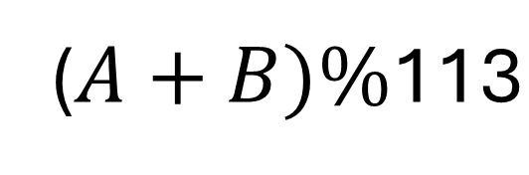
Can we understand Transformer circuits?
($A+B)\%\text{113}$
$$A,B$$
Neel Nanda et al. ”PROGRESS MEASURES FOR GROKKING VIA MECHANISTIC INTERPRETABILITY” 2023

Slide 6
How to identify what computation a part is doing?

Slide 7
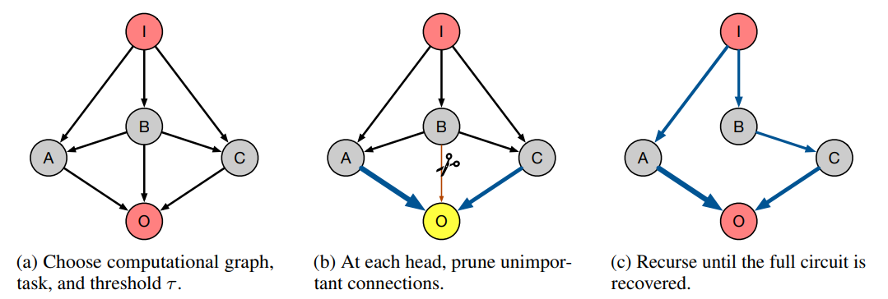
Ablating (taking out the connection)
“Towards Automated Circuit Discovery for Mechanistic Interpretability” Conmy et al. 2023

Slide 8
Logit attribution
Taking the output of a single component
Evolving it in isolation through the rest of the transformer
Like Logit Lens
But grants a more detailed view

Slide 9
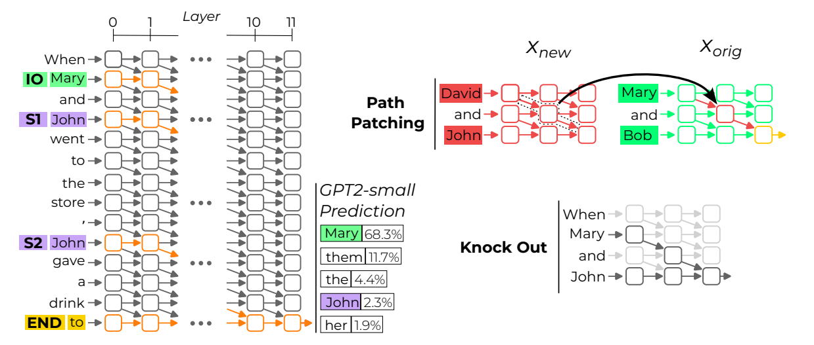
Path Patching
“INTERPRETABILITY IN THE WILD: A CIRCUIT FOR INDIRECT OBJECT IDENTIFICATION IN GPT-2 SMALL ” Wang et al. 2022

Slide 10
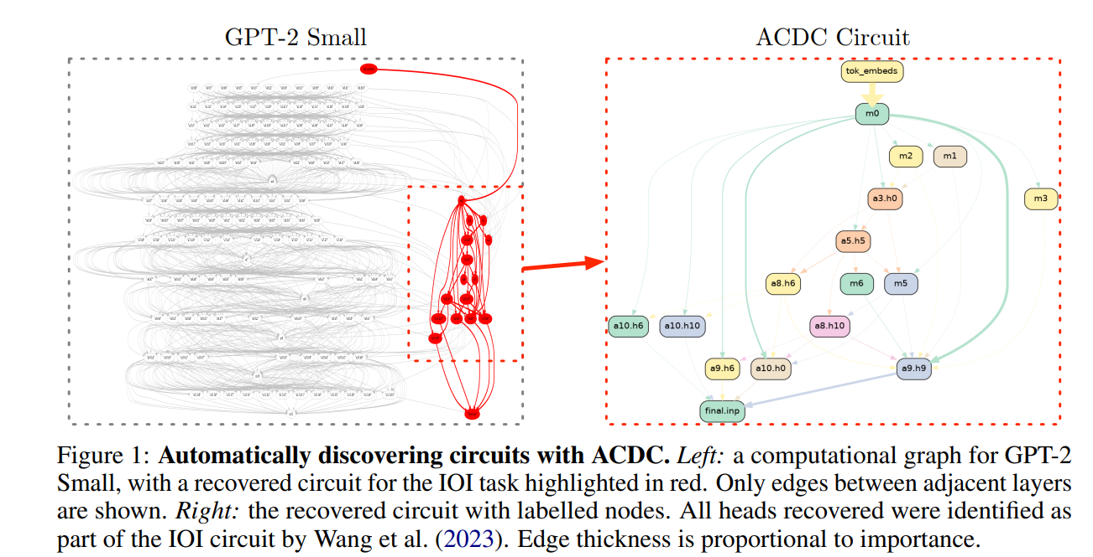
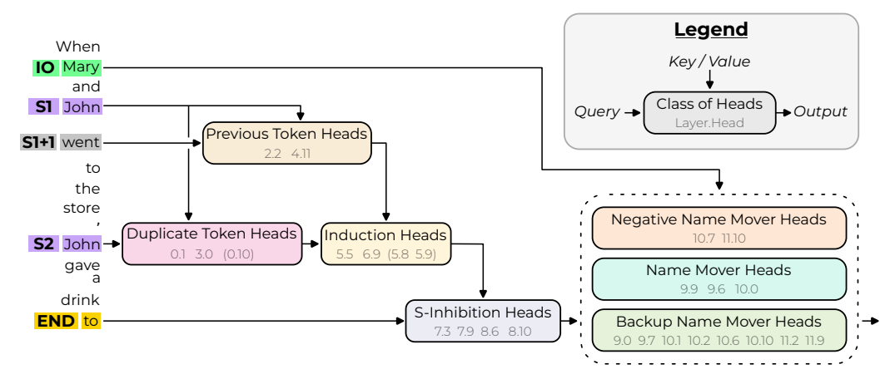
Discovery of the “IOI” circuit
Path patching
“INTERPRETABILITY IN THE WILD: A CIRCUIT FOR INDIRECT OBJECT IDENTIFICATION IN GPT-2 SMALL ” Wang et al. 2022
Ablation (ACDC)
“Towards Automated Circuit Discovery for Mechanistic Interpretability” Conmy et al. 2023

Slide 11
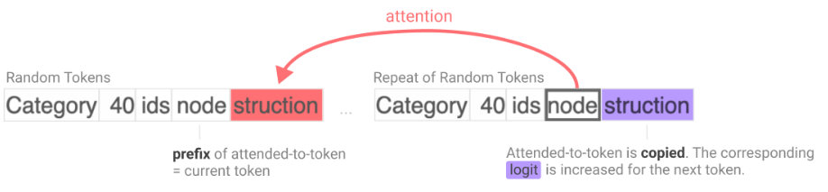
Circuits in LLMs: Induction Heads
How to implement Induction in an LLM?
Neel Nanda et al. ” In-context Learning and Induction Heads” 2022

Slide 12
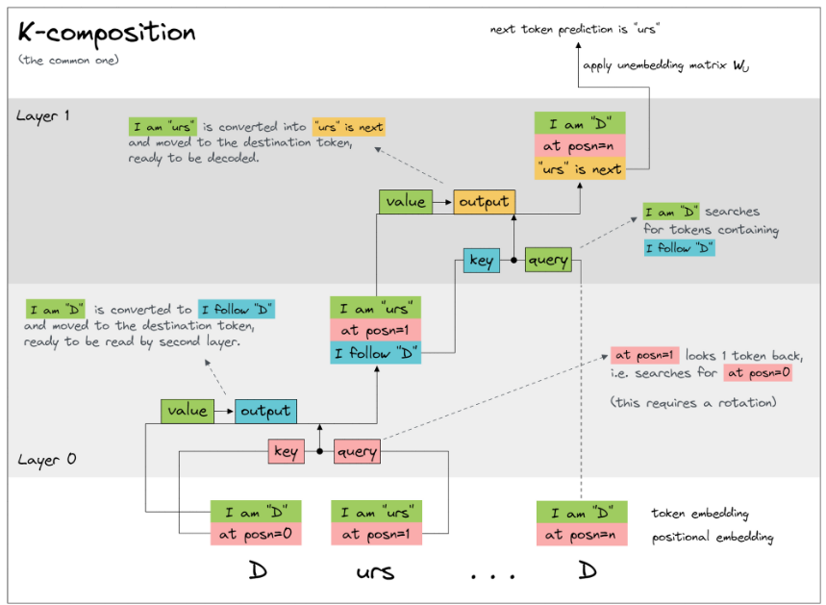
CallumMcDougall” Induction heads - illustrated” 2023

Slide 13
Attention at previous mention of same token
Attention at previous token
CallumMcDougall” Induction heads - illustrated” 2023

Slide 14
K-composition
What is my first name?
James!
What name are you?
Potter!
James
Potter
James

Slide 15
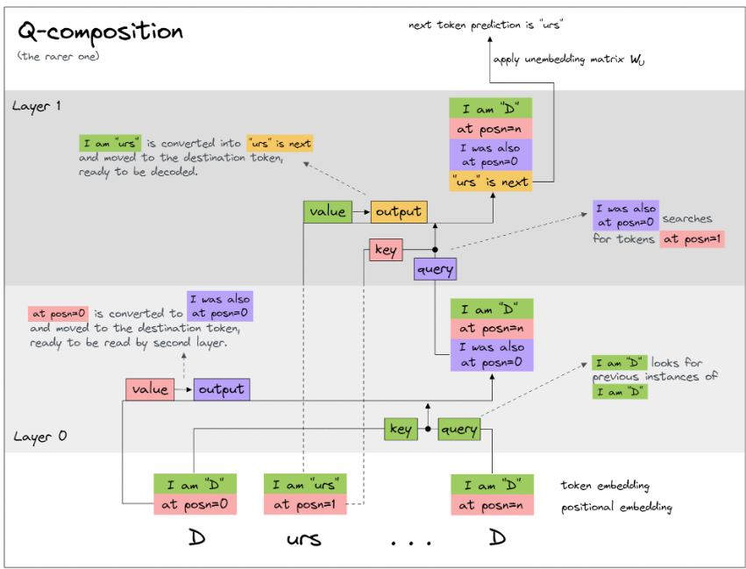
CallumMcDougall” Induction heads - illustrated” 2023

Slide 16
Attention at previous mention of next token
Attention at previous mention of same token

Slide 17
Q-composition
What is in position n+1?
Potter!
James
Potter
James
What is your position?
n!

